Slide 1
4CEIT1:Operating System

Slide 2
BOOK
Modern Operating Systems By Andrew S. Tanenbaum, Third Edition PHI
Operating Systems Internals and Design Principles , William Stallings , Seventh Edition, Prentice Hall.
Operating Systems, D.M.Dhamdhare, TMH

Slide 3
What is OS
Resource Manager
An Operating System (OS) is an interface between a computer user and computer hardware. An operating system is a software which performs all the basic tasks like file management, memory management, process management, handling input and output, and controlling peripheral devices such as disk drives and printers

Slide 4
What is OS
An Operating System (OS) is a software that acts as an interface between computer hardware components and the user. Every computer system must have at least one operating system to run other programs. Applications like Browsers, MS Office, Notepad Games, etc., need some environment to run and perform its tasks.

Slide 5
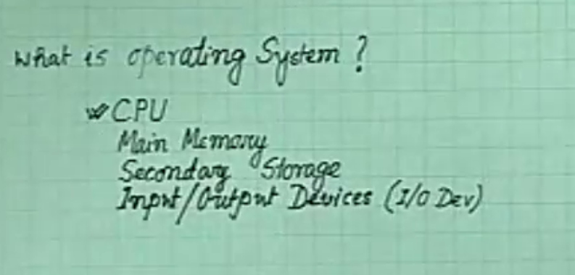
Resources

Slide 6
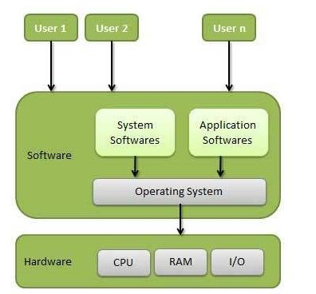

Slide 7
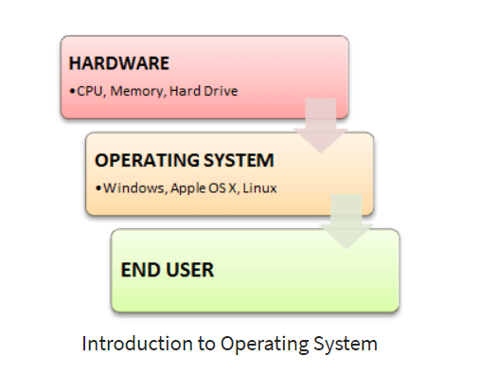

Slide 8
History Of OS
Operating systems were first developed in the late 1950s to manage tape storage
The General Motors Research Lab implemented the first OS in the early 1950s for their IBM 701
In the mid-1960s, operating systems started to use disks
In the late 1960s, the first version of the Unix OS was developed
The first OS built by Microsoft was DOS. It was built in 1981 by purchasing the 86-DOS software from a Seattle company
The present-day popular OS Windows first came to existence in 1985 when a GUI was created and paired with MS-DOS.

Slide 9
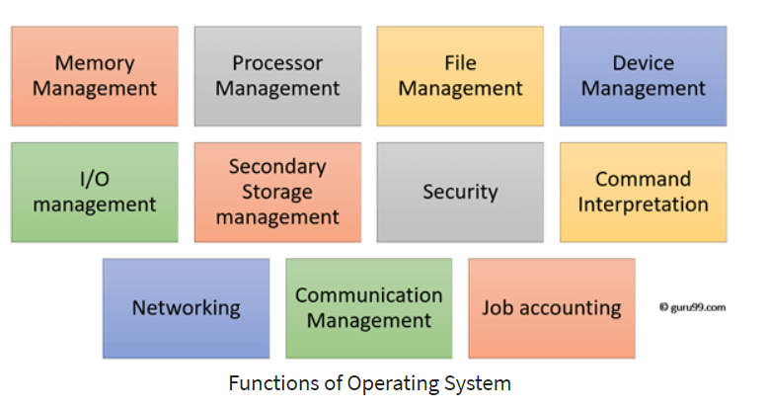
Functions of Operating System

Slide 10
Functions of Operating System
Process management:- Process management helps OS to create and delete processes. It also provides mechanisms for synchronization and communication among processes.
Memory management:- Memory management module performs the task of allocation and de-allocation of memory space to programs in need of this resources.
File management:- It manages all the file-related activities such as organization storage, retrieval, naming, sharing, and protection of files.

Slide 11
Functions of Operating System
Device Management: Device management keeps tracks of all devices. This module also responsible for this task is known as the I/O controller. It also performs the task of allocation and de-allocation of the devices.
I/O System Management: One of the main objects of any OS is to hide the peculiarities of that hardware devices from the user.
Secondary-Storage Management: Systems have several levels of storage which includes primary storage, secondary storage, and cache storage. Instructions and data must be stored in primary storage or cache so that a running program can reference it.

Slide 12
Functions of Operating System
Security:- Security module protects the data and information of a computer system against malware threat and authorized access.
Command interpretation: This module is interpreting commands given by the and acting system resources to process that commands.
Networking: A distributed system is a group of processors which do not share memory, hardware devices, or a clock. The processors communicate with one another through the network.
Job accounting: Keeping track of time & resource used by various job and users.
Communication management: Coordination and assignment of compilers, interpreters, and another software resource of the various users of the computer systems.

Slide 13
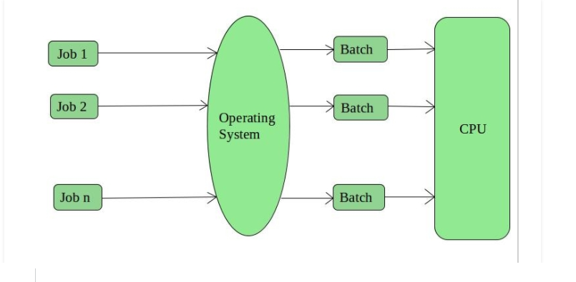
Types of OS
Batch Operating System –

Slide 14
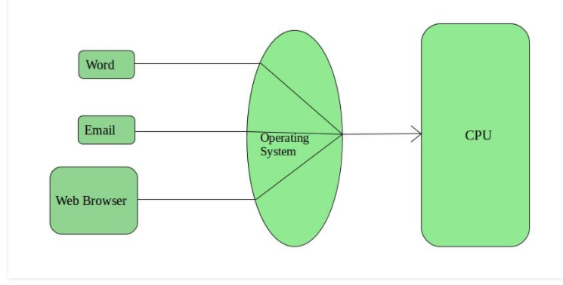
Types of OS
2. Time-Sharing Operating Systems –

Slide 15
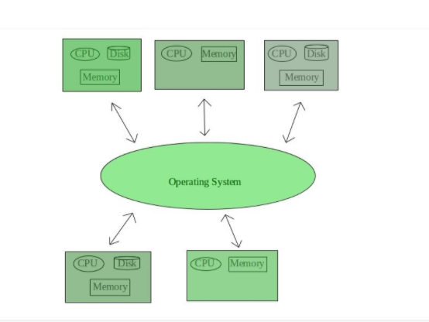
Types of OS
3. Distributed Operating System –

Slide 16
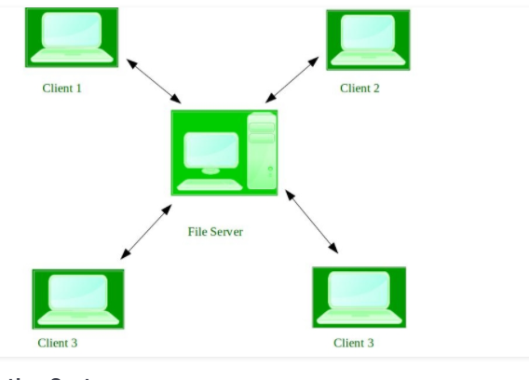
Types of OS
4. Network Operating System –

